Slide 1
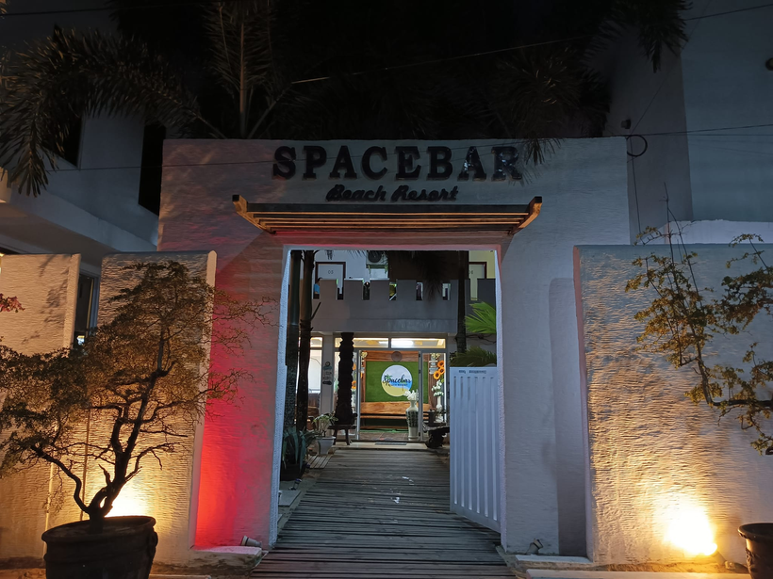




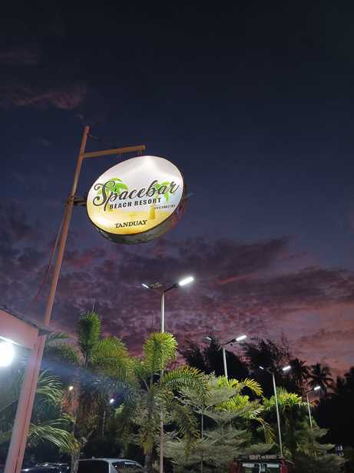
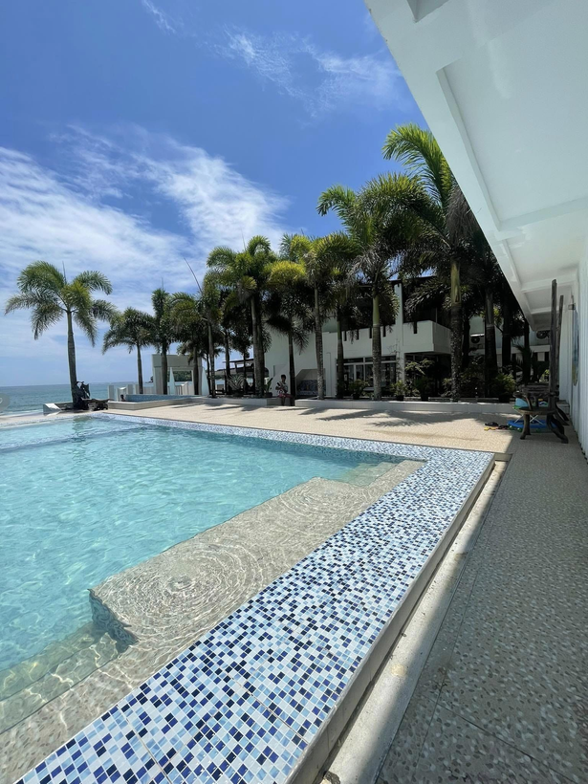



S
B
Experience the perfect vacation
S
B
Time to relax!
Oasis Space Bar
Jardin, Gamao, Lugenges
TRIPLE
OYALS

Slide 2







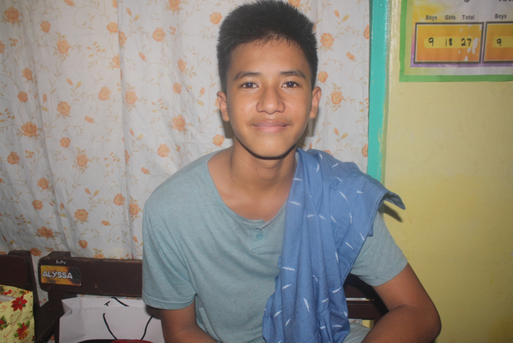




Meet the Group
TRIPLE
OYALS
LUAN SEBASTIAN
JARDIN
JESS
LUENGAS
JONREFF MAXEY GAMAO

Slide 3
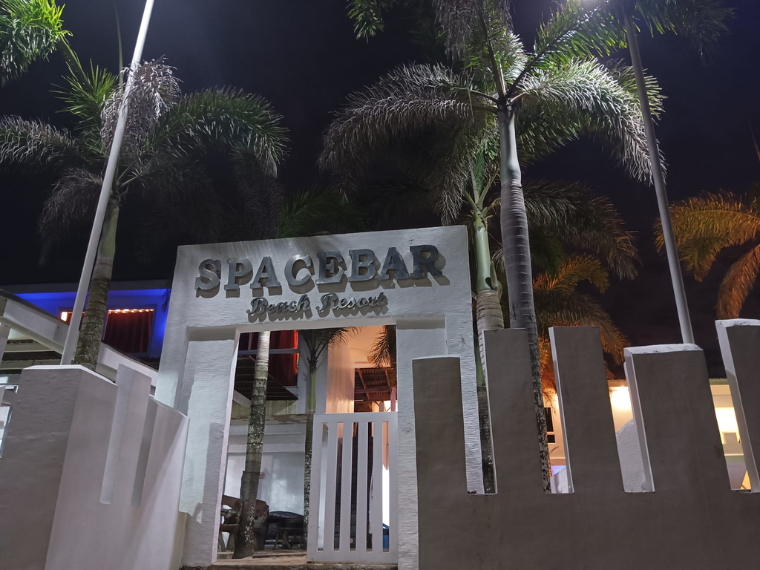
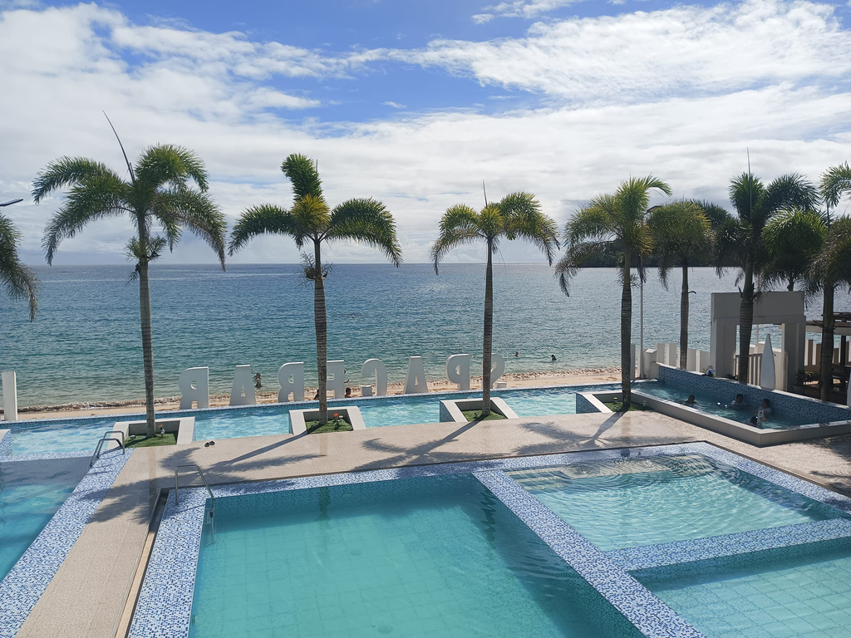
What is Oasis Space Bar?
Need a place to unwind? A place to not just exist but to be and feel alive? Then, take the most enchanting and colorful escape you'll ever experience only achievable at Spacebar beach resort found at the soul of Cagwait Surigao del Sur.
To make it more exciting, the Spacebar Management is preparing lots of surprises as to why they're still under construction and on the process of building greater and much more enjoyable features of its own.

Slide 4
Logo
Design Elements
Sunset Background:
The design features a prominent yellow-orange sunset.
The sun is partially obscured, giving a warm and inviting feel.
White birds are silhouetted against the sun, adding a dynamic element.
Surfer Alien:
An alien character is surfing on a wave.
The alien is green with a typical 'extraterrestrial' look (large eyes, small body).
The surfboard and waves add a playful, beachy vibe.
Waves:
Blue waves are shown in front of the sunset.
The waves emphasize the beach theme and add motion to the design.
Text "SB":
The large letters "SB" are prominently placed in the center.
"SB" stands for Space Bar.
The text has a 3D effect with shading, making it stand out.
MAIN LOGO FEATURES
S
B
S
B
Logo Mark
Word Mark

Slide 5

Scope and Limitations
Scope
Limitations
Technical constraints: Ensuring app compatibility across devices.
Security constraints: Protecting user data and payment information.
Regulatory constraints: Complying with data protection and online transaction laws.
Development of a user-friendly mobile application for luxury resort bookings.
Integration of automation features while maintaining personalized service.
Accessibility for diverse user preferences.

Slide 6

Application Overview
Description:
Key Features:
Availability Checker
Room Comparison
Secure Booking
Special Requests
Booking Management
A mobile app to simplify and streamline luxury resort reservations.
Features include browsing available dates, exploring room options, making reservations, and managing bookings.

Slide 7
Motivation - what problem are you addressing?
Luxury resorts like Oasis Spacebar use two booking systems: manual and automated. Manual booking provides personalized service and direct interaction but is time-consuming and less accessible. Automated booking is quick, allows easy comparisons, and offers secure online payments but can cause confusion and technical problems. A hybrid approach could combine the benefits of both, letting guests start online bookings, get help from staff, or complete bookings in person. This flexible model caters to different preferences and improves the overall booking experience.
Notes:
The problem we are addressing is the cumbersome and often unreliable process of reserving leisure spaces, such as beach spots or rooms, using traditional methods like phone calls or emails. These methods are inefficient, prone to errors, and often lack transparency regarding availability and booking conditions. Our app, Oasis Spacebar, aims to streamline this process by providing a user-friendly, efficient, and transparent reservation system.

Slide 8
Top Requirements
From user feedback and initial surveys, we identified the following top requirements for the Oasis Spacebar app:
Ease of Use: The app must be intuitive and easy to navigate, allowing users to make reservations with minimal effort.
Clear Information: Users need clear, concise information about availability, pricing, and booking conditions.
Error Prevention and Recovery: The app should prevent common user errors and provide clear instructions for recovering from any issues.
User Control: Users should have the flexibility to modify or cancel reservations easily.
Accessibility: The app should be accessible to all users, including those with disabilities.

Slide 10
Evaluation
Heuristic
5e’s
Survey (Google Forms)

Slide 11
Heuristic | Description | Identified Issues | Severity Rating | Recommendations
Visibility of system status | Users need to know their booking progress. | No progress indicators. | Medium | Add progress indicators.
Match between system and the real world | Terminology should match user expectations. | Complex terminology in descriptions. | High | Simplify and clarify terminology.
User control and freedom | Users need to easily undo actions. | No undo feature. | High | Add an undo option.
Consistency and standards | Icons and buttons should be consistent. | Inconsistent use of icons/buttons. | Medium | Standardize icons and buttons.
Error prevention | Users shouldn't submit incomplete forms. | No form validation. | High | Implement form validation.
Recognition rather than recall | Users should not have to remember information. | None identified. | None | None needed.
Flexibility and efficiency of use | App should cater to experienced users. | No shortcuts or advanced filters. | Medium | Add shortcuts and advanced filters.
Aesthetic and minimalist design | Design should be simple and functional. | Visual clutter. | Low | Remove unnecessary elements.
Help users recognize, diagnose, and recover from errors | Error messages should be helpful. | Generic error messages. | High | Improve error message details.
Help and documentation | Help resources should be easy to find. | Help section hard to find. | Medium | Make help resources more accessible.

Slide 12
Evaluation Aspect | Criteria | Results | Insights and Comments
Effectiveness | Success Rate | 85% | Users were generally successful in completing booking tasks, but encountered issues with modifying bookings.
 | Accuracy | High | Room selection and reservation details were accurately processed.
Efficiency | Time Taken | 2.5 min | Average time users spent to search for rooms and complete bookings.
 | Steps/Clicks | Moderate | Users found the process slightly cumbersome due to multiple steps.
Engagement | Visual Appeal | 4.0/5 | Users appreciated the modern design but suggested more interactive elements.
 | User Satisfaction | Positive | Generally satisfied with the interface and features.
Error Tolerance | Error Messages | 3.5/5 | Users appreciated error alerts but found some messages lacked clear guidance.
 | Recovery | Moderate | Users could recover from errors with some effort.
Ease of Learning | Learning Curve | 3.8/5 | New users found the app relatively easy to navigate but suggested clearer instructions.
 | Complexity | Moderate | Some features were perceived as complex for new users

Slide 13
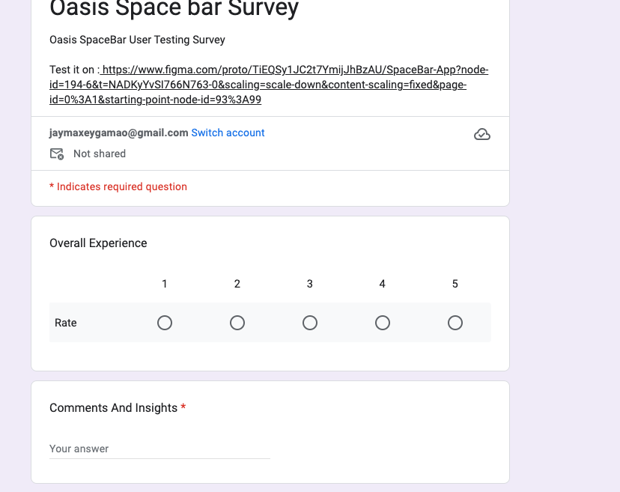
Question | Average Rating (1-5) | Comments and Insights
Overall Experience | 3.8 | Users found the app generally user-friendly but suggested improvements in navigation.
Navigation Clarity | 3.5 | Mixed feedback on ease of finding features; suggestions for clearer menu structure.
Visual Design | 4.0 | Positive responses to modern aesthetics and intuitive layout; desire for more customization options.
Booking Process | 3.9 | Generally smooth booking process; some users requested clearer instructions during certain steps.
Information Clarity | 3.2 | Some users found booking details straightforward, while others requested clearer explanations of terms and policies.
Error Handling | 3.6 | Users appreciated error messages but suggested more detailed explanations and solutions.
Suggestions for Improvement | - | Multiple suggestions for additional features and enhanced user guidance.

Slide 14
Conclusion
The evaluation of the Oasis Spacebar app prototype revealed several strengths, including a modern and visually appealing design, and a generally user-friendly interface. However, there are areas for improvement, particularly in error prevention, user control, and help documentation. If we had more time, we would focus on the following:
Enhanced Navigation: Simplify the booking process by reducing the number of steps and adding clear navigation options such as a 'Back' button and undo features.
Improved Error Handling: Provide more detailed and user-friendly error messages with actionable guidance to help users resolve issues.
Comprehensive Help Resources: Integrate easily accessible help sections, FAQs, and contextual help icons to support users in real-time.
Customization and Flexibility: Introduce features like keyboard shortcuts and advanced search filters to cater to experienced users and enhance overall efficiency.
By addressing these areas, we aim to improve the overall usability and user satisfaction of the Oasis Spacebar app, making it a more effective and enjoyable tool for booking leisure spaces.

Slide 15


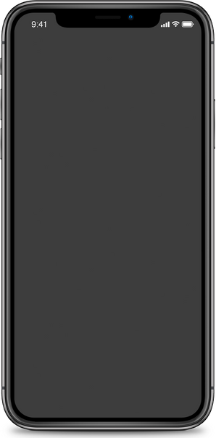

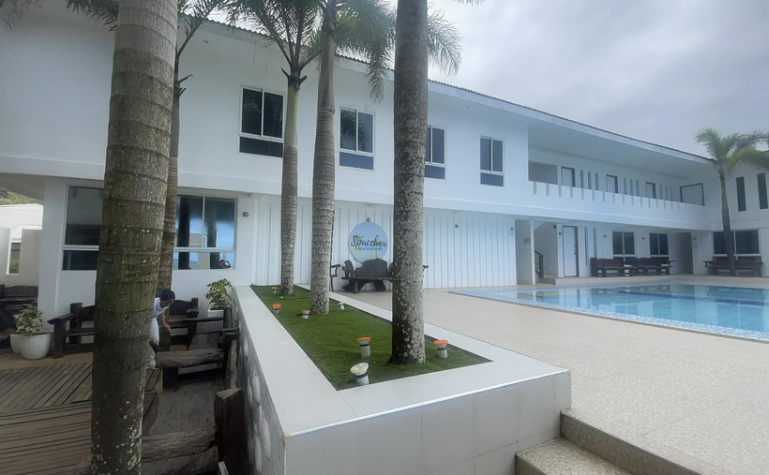
Time to relax!
Thank you
For Listening
S
B
S
B

